Slide 1
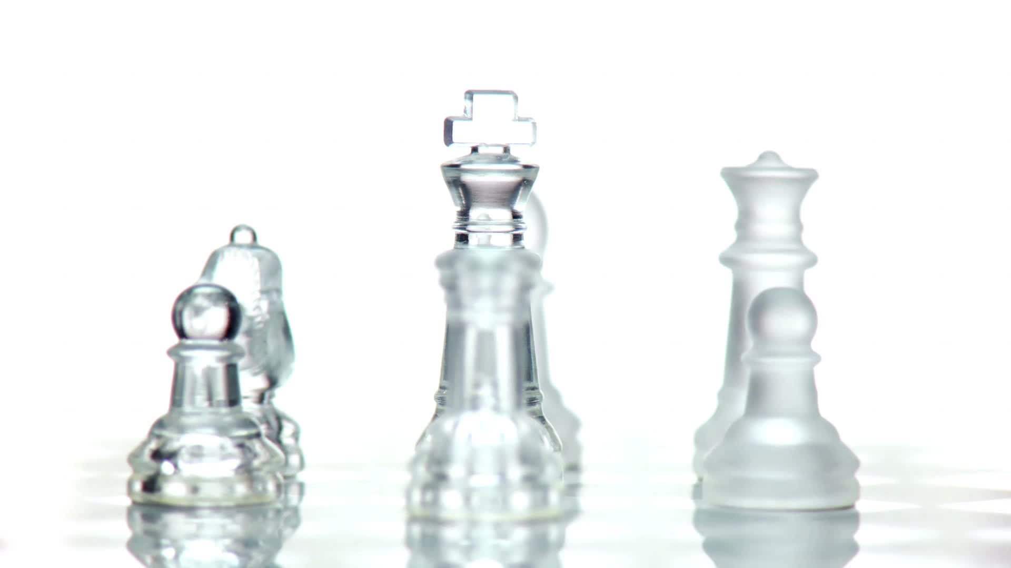
Learn by Gaming
Critical Thinking

Slide 2

Introduction
Learning can be:
Boring
Monotonous
Un-interactable
Learning should be:
Fun
Engaging
Immersive

Slide 3

Teaching Styles

Slide 4

Traditional Teaching Method

Slide 5

Gamification

Slide 6


Gaming

Slide 7

Proof of Concept
Caldas, L.M., Eukel, H.N., Matulewicz, A.T., Fernández, E.V. and Donohoe, K.L. (2019). Applying educational gaming success to a nonsterile compounding escape room. Currents in Pharmacy Teaching and Learning, 11(10), pp.1049–1054.

Slide 8
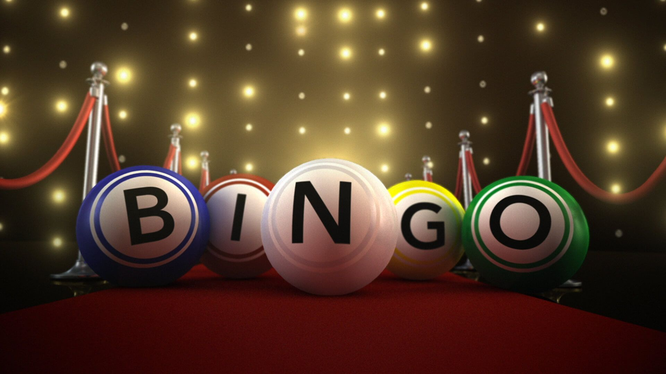
Proof of Concept
Dorfner, N. and Zakerzadeh, R. (2021). Academic Games as a Form of Increasing Student Engagement in Remote Teaching. Biomedical Engineering Education.

Slide 9

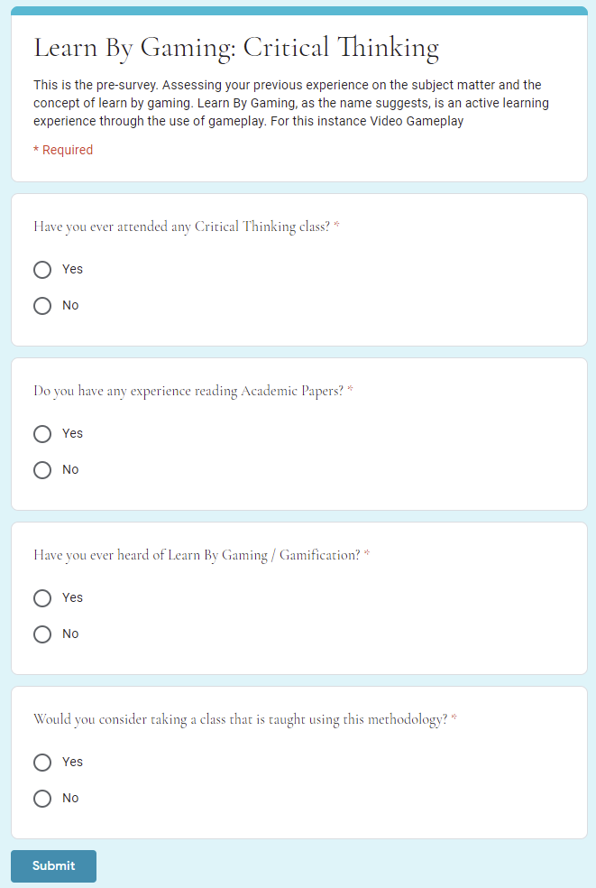
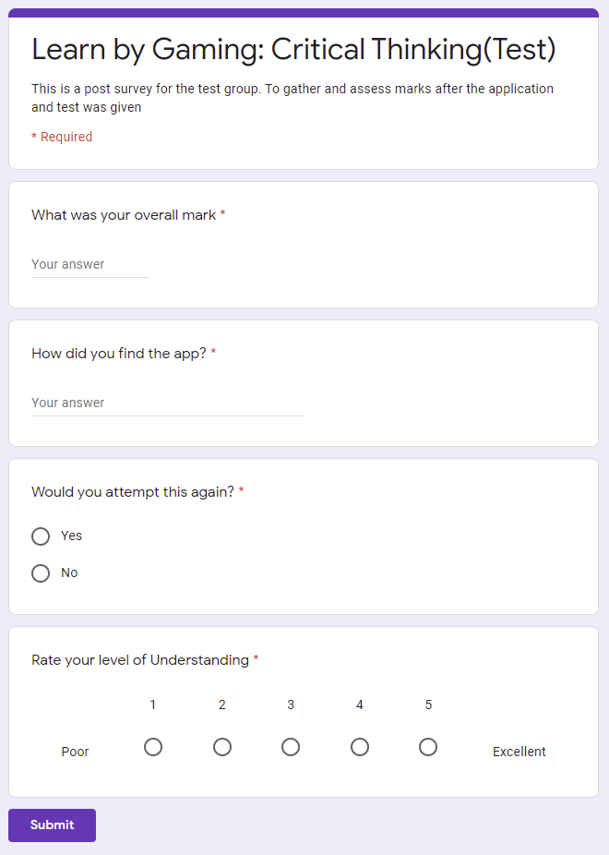
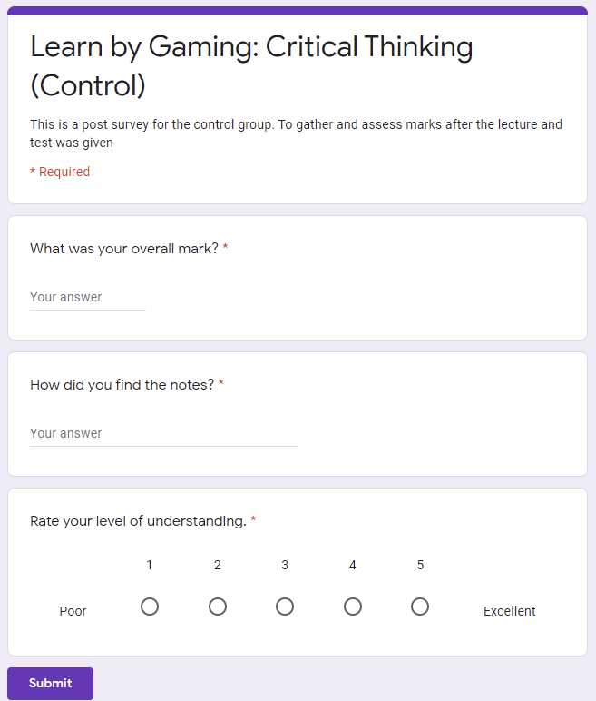
Survey

Slide 10



Methodology

Slide 11

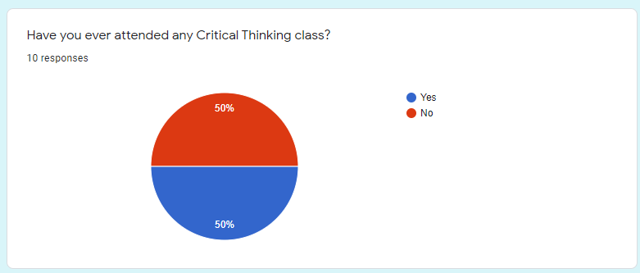
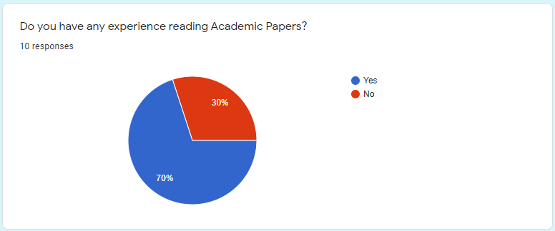
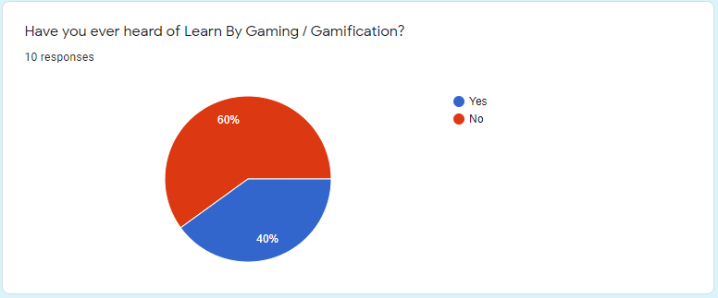

Results Pre-Survey

Slide 12
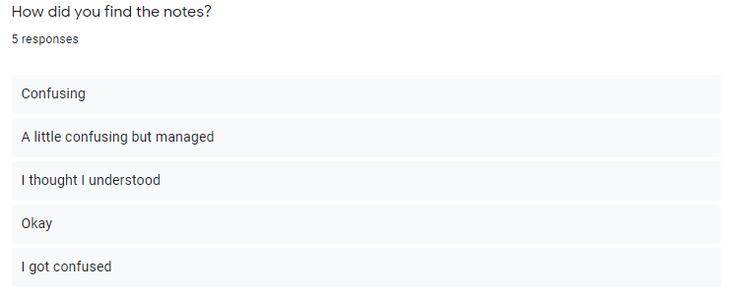
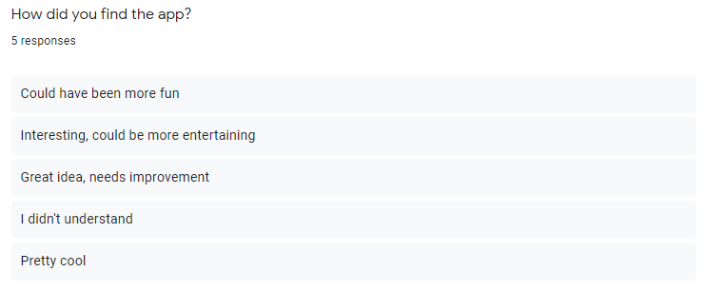
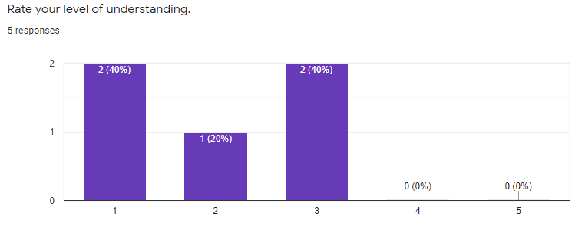
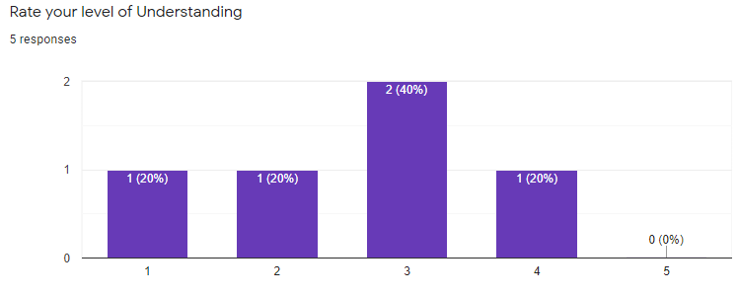
Results Post-Survey
Test
Control

Slide 13

Conclusion

